Slide 1
Kmeans Clustering
By Lens Desrouleaux

Slide 2
Kmeans Clustering
Unsupervised MLA
Non-parametric method of clustering
Amount of clusters must be defined by programmer as it is not learned by the model

Slide 3
Steps of Kmeans Clustering
Determine K
Initialize K points randomly as cluster centers
Assign each datapoint to closest cluster
Compute centroid of each cluster
Centroid is new cluster center
If not converged repeat from step 3

Slide 4
Kmeans info
Seeks to minimize distance between cluster centers while maximizing distance between clusters themselves
Distortion: the sum of the squared distances between each observation (n) and its dominating centroid
Centroid: Average position of all points in a cluster

Slide 5
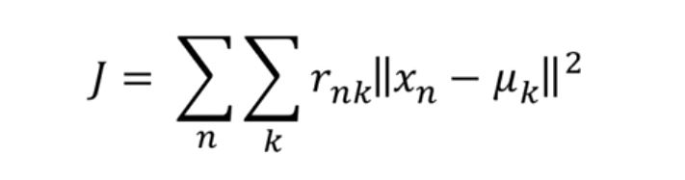
Distortion Equation
J: Distortion value
X_{n}: Sample n
U_{k}: Cluster center of cluster K
R: Cluster Membership, either 0 or 1

Slide 6
How to Determine K
Too many or too few clusters , there isn’t enough differentiation
Find where the Silhouette value peaks
Silhouette Value judges how a point matches it’s cluster
Ranges from -1 to 1, closer to 1 the more it matches it’s cluster and the least like other clusters it is

Slide 7
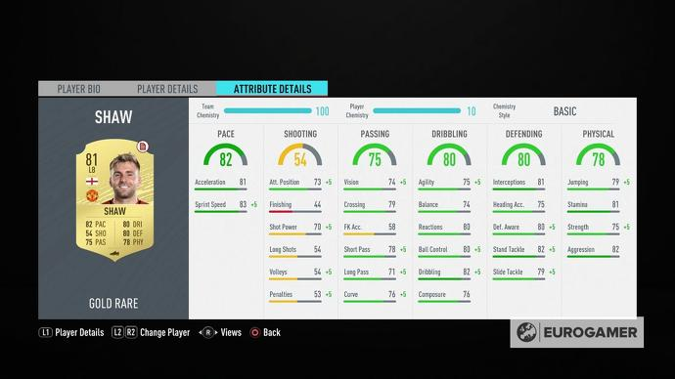
Why Apply this to Fifa Cards?
All players are made using attributes
Standardized stats (every attribute is from 1-100)
Similar players have similar attributes and play styles

Slide 8
Demonstration

Slide 9
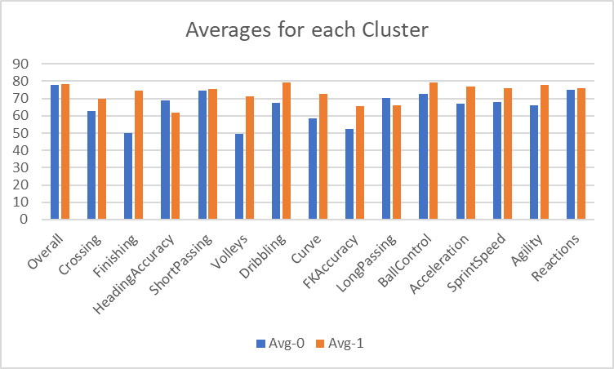
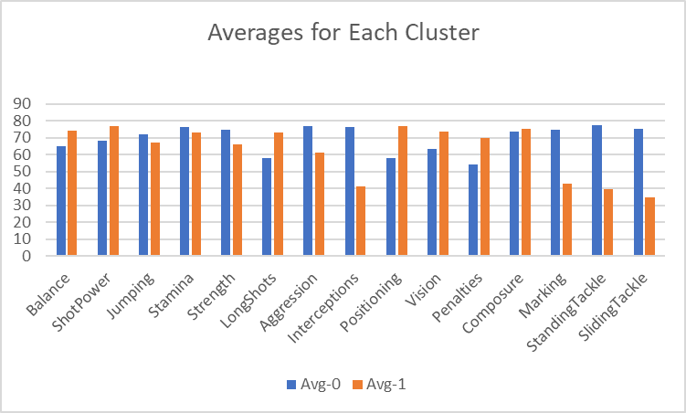
Averages Across All Attributes

Slide 10
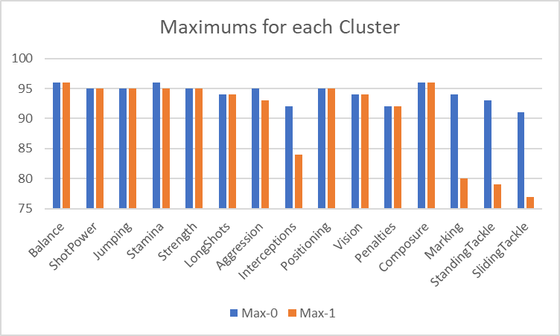
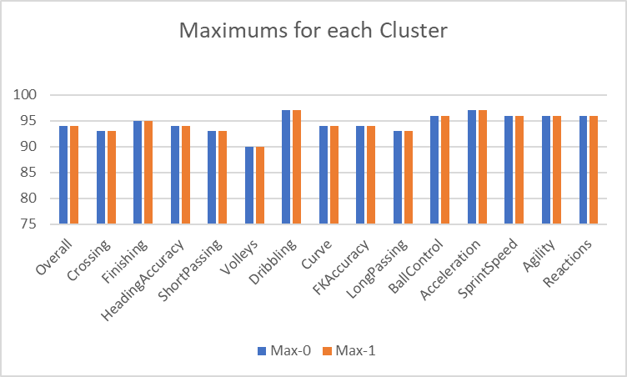
Maximums For Each Cluster

Slide 11
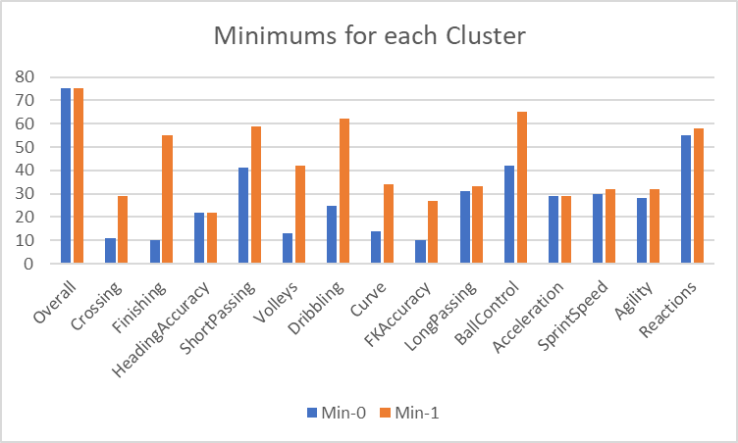
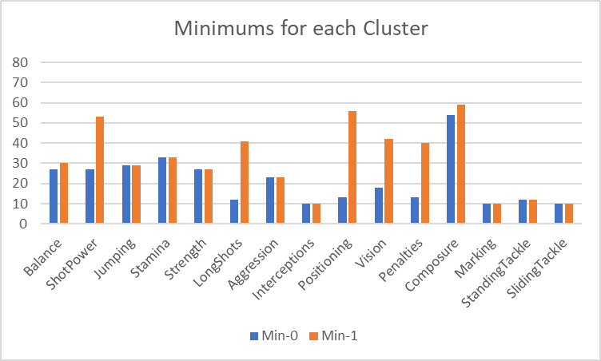
Minimums for each Cluster

Slide 12
Players in Cluster 0
Significantly better in tackling
Significantly better in man marking
Much better in off-ball play
Better suited for defensive roles
More well-rounded

Slide 13
Players in Cluster 1
Better shooters
Better long passers
Better passers overall
Better ball handlers
Faster but worse stamina
Better suited for offensive roles

Slide 14
Other Uses of clustering
Studying shopping habits and trends and grouping together similar consumers
Detecting bots
Group images
Identify groups in health monitoring
Grouping similar players in fantasy sports

Slide 15
Questions?

Slide 16
Additions

Slide 17
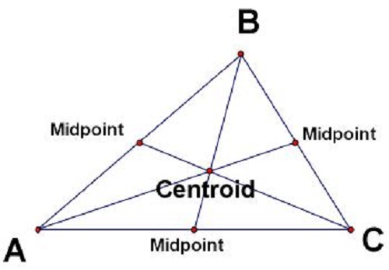
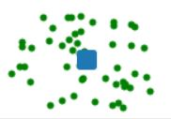
Centroids
Center of mass in a geometric object
The center of a cluster

Slide 18
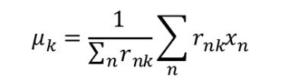
How to find centroids
Found just like a mean in a normal set of data
Add all the samples belonging to that cluster
Divide by the number of samples

Slide 19
Time Complexity
Average:O(nik)
Worst Case: O(n^{(k+2/d)})
Worst case time complexity changes by dataset and implementation
Dependent on data size: n
Dependent on iterations: I
Dependent on clusters: k
Dependent on attributes/dimensionality: d

Slide 20
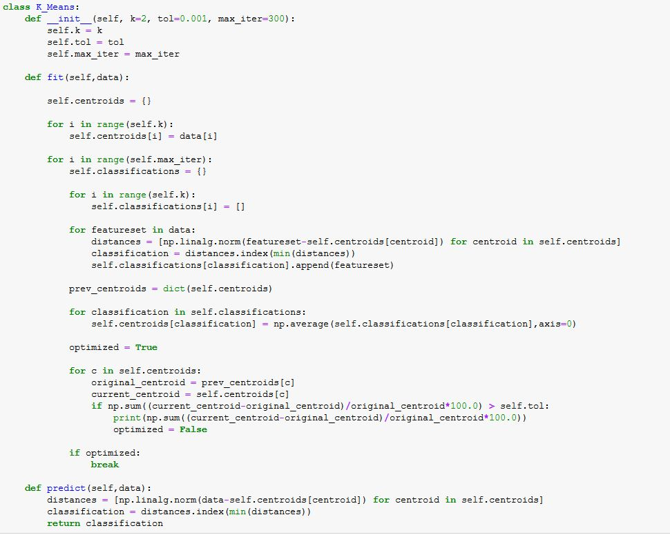
Code

Slide 21
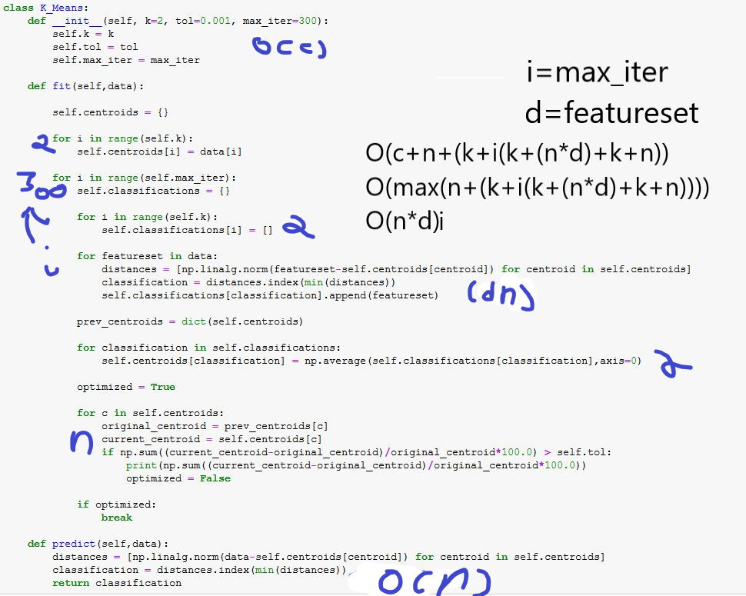
Big-o Breakdown

Slide 22
Works Cited
Arthur, David, and Sergei Vassilvitskii. How Slow is the K-Means Method?, Stanford. https://theory.stanford.edu/~sergei/papers/kMeans-socg.pdf
Dagli, Rishit. "Build K-Means from Scratch in Python." Medium, Oct 29, 2019. https://medium.com/@rishit.dagli/build-k-means-from-scratch-in-python-e46bf68aa875
Galarnyk, Michael. "PCA using Python (Scikit-Learn)." Towards Data Science, Dec 7, 2017.
https://towardsdatascience.com/pca-using-python-scikit-learn-e653f8989e60
Halthor, Ajay. K-Means Clustering - EXPLAINED!. 2018, https://www.youtube.com/watch?v=O6b2L_lYH9k.
Leone, Stefano. "FIFA 20 Complete Player Dataset.", Sep 26, 2019, https://www.kaggle.com/stefanoleone992/fifa-20-complete-player-dataset#players_20.csv.
The base file for all the data used in the analysis.
Moffitt, Chris. "Using WSL to Build a Python Development Environment on Windows " Practical Business Python,
https://pbpython.com/wsl-python.html
"Python Tutorial for Programmers - Python Crash Course." , directed by Mosh Hamedi. , produced by Mosh Hamedi. , performance by Mosh Hamedi. , Programming with Mosh, 2018.
https://www.youtube.com/watch?v=f79MRyMsjrQ
"Sklearn.Cluster.KMeans — Scikit-Learn 0.22.2 Documentation.", 2020,
https://scikit-learn.org/stable/modules/generated/sklearn.cluster.KMeans.html.

